Slide 1
RSC policy and Contaminants of Emerging Concern
Tanya Sheridan
Head of Policy & Evidence
December 2024

Slide 2
The Royal Society of Chemistry is a learned society, professional body, charity not for profit publisher and global community of scientists
Our charitable purpose is to help the chemical science community make the world a better place
About 60 000 members, living in over 100 countries

Slide 3
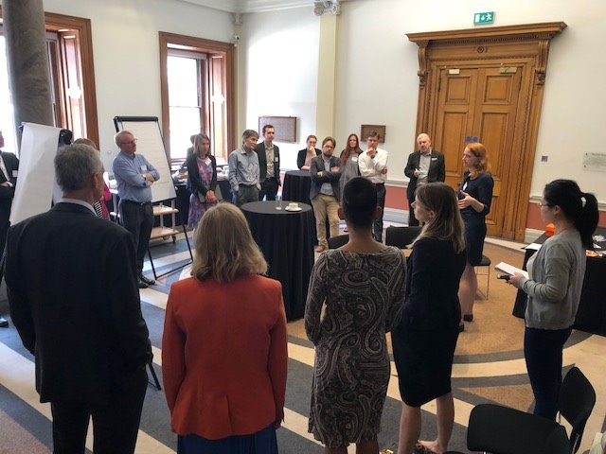
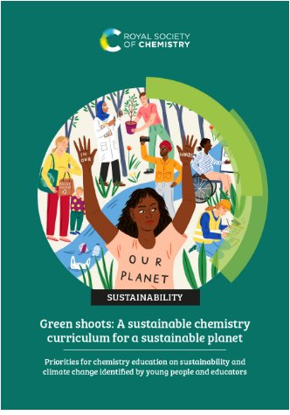
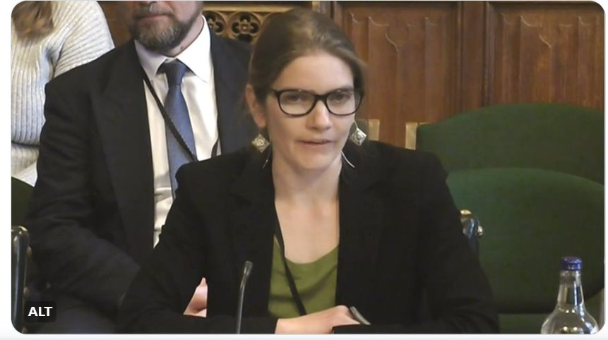
Shaping policy with the chemical sciences community
Research & innovation Funding and policy
Higher Education
Sustainable chemicals policy
Science Culture
Our roles
Convening the chemistry community
Drawing on members’ expertise to develop policy content
Advising Governments, Parliaments, international organisations
Circular Economy
Expert school and college workforce
Net Zero and supply chains
Future Workforce &skills
Tackling pollution (air, water, AMR)
Relevant and resourced curriculum
Equality, diversity and inclusion
Accessible routes and equitable pathways

Slide 4
Our waters are increasingly contaminated with chemicals and plastics…
Contaminants of emerging concern (CECs) are substances that are often not controlled or monitored in the environment, and even at low concentrations may be harmful to human health or the environment.

Slide 5
CECs - an invisible threat?
Sources of CECs include sewage, treated wastewater, run-off from agricultural fields and roads, landfill leachate and industrial emissions.
Their presence in the environment can be concerning due to their potential toxicity, persistence, and ability to accumulate in organisms.
Interested in the RSC’s work on this topic? Find out more at rsc.li/CECs

Slide 6
What are scientists doing to tackle this issue?
Prof. Barbara Kasprzyk-Horden
Prof. Tamara Galloway
Dr. Leon Barron

Slide 7
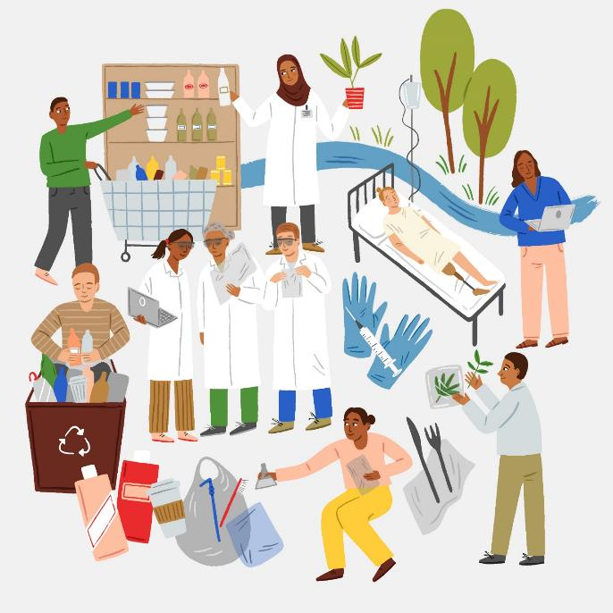
Thanks for listening…
Sustainability policy, evidence and campaigns: rsc.li/sustainability
Get in touch with us: policy@rsc.org

