Slide 1
Building a Healthcare Science Workforce Equipped to Face the Grand Challenges
A Clinical Engineering Focus
Dr Victoria Kidgell
PhD, CSci, MIPEM
Lead Clinical Scientist, Clinical Engineering
Sheffield Teaching Hospitals NHS FT
Chair IPEM’s Clinical Engineering Special Interest Group

Slide 2
IPEM’s Grand Challenges and Emerging Trends
Grand Challenges
Emerging Trends
Alignment and Collaboration
Workforce
Climate Change
Clinical Safety and Security
Smart Digitisation
Personalised Health
Notes:
Grand challenges are major challenges that
are increasingly affecting healthcare sciences:
— Staffing and workforce
— Climate change
— Safety and security
Emerging trends are technologies, enabling platforms and ideas that could be harnessed to address the grand challenges and make positive changes to the health and care research and delivery ecosystem:
— Alignment and collaboration
— Smart digitisation
— Personalised health

Slide 3
Building Resilience in the NHS
Dealing with challenges:
Workforce challenges
Pandemics and winter flu epidemics
Carbon net-zero & sustainability targets
Obligation to the Public:
Supporting an ageing population
Providing high-quality patient-centred care
Providing healthcare that is available to all
Removing/reducing healthcare inequalities

Slide 4
The Role of Healthcare Scientists and Clinical Engineers
Ensuring patient care and safety
Driving innovation
Improving patient care
Contributing to sustainability
Notes:
Ensuring Patient Safety and Care:
Designing, testing, and maintaining critical medical equipment (e.g., ventilators, infusion pumps).
Developing safety protocols to minimise risks in medical device usage.
Driving Innovation:
Pioneering advancements in medical devices such as robotics, imaging technologies, and implantable systems.
Supporting personalized medicine through genomics and bioinformatics.
Improving Patient Care:
Streamlining clinical workflows with advanced diagnostic and therapeutic equipment.
Ensuring the safety, reliability, and maintenance of medical devices.
Contributing to Sustainability:
Designing devices with a focus on energy efficiency and recyclable materials.
Supporting NHS sustainability goals through smarter procurement and device lifecycle management.

Slide 5
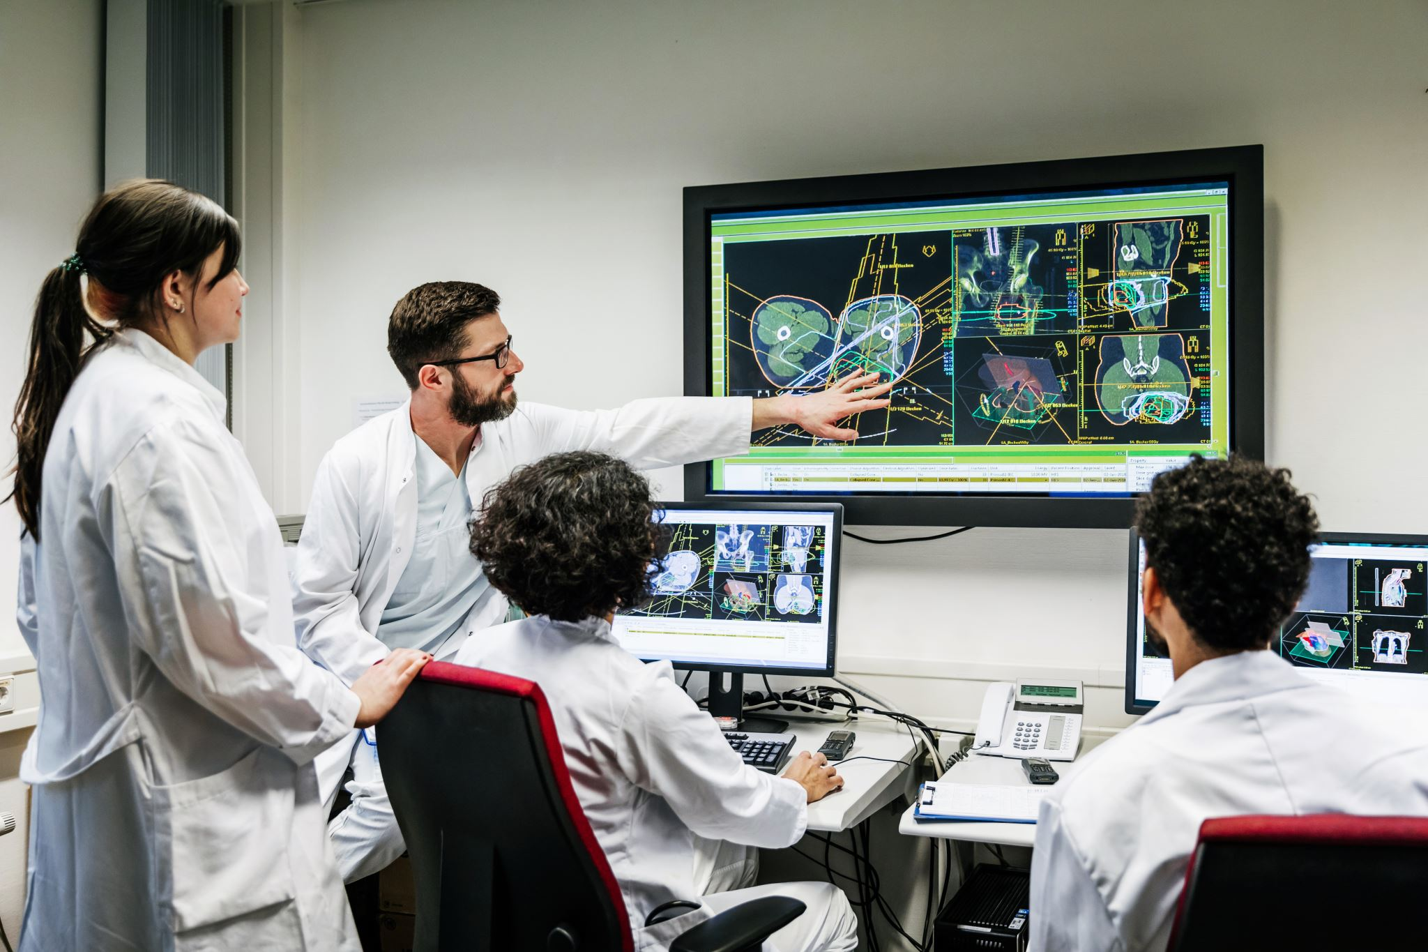
Developments in Medical Devices: Improving Patient Care
Enhanced Diagnostics
Personalised Treatment
Remote Monitoring & Telemedicine
Virtual Wards and Hospital at Home
Minimally Invasive Procedures
Automation & AI in Healthcare
Regenerative Medicine
Notes:
Enhanced Diagnostics – AI-driven imaging, wearable biosensors, and point-of-care testing enable faster and more accurate diagnoses.
Personalised Treatment – 3D-printed implants, smart drug delivery systems, and precision medicine optimize patient-specific treatments.
Remote Monitoring & Telemedicine – Wearable devices and interconnected smart device solutions allow real-time monitoring of chronic conditions, reducing hospital visits.
Minimally Invasive Procedures – Robotic-assisted surgery and advanced endoscopic tools lead to quicker recovery and reduced complications.
Automation & AI in Healthcare – AI-powered decision support tools improve clinician efficiency and reduce errors.
Regenerative Medicine – Innovations in stem cell therapy, bioengineered tissues, and organ-on-a-chip technology are revolutionizing treatment.

Slide 6
Developments in Medical Devices: Need for New Skills
Digital and Data Driven Skills:
Connectivity
AI and machine learning
Data science and big analytics
Regulatory and Cybersecurity Skills:
Medical device cybersecurity
Regulatory affairs and compliance
Innovation Skills:
Healthcare technology management
Technology commercialisation
Ability to work in multi-disciplinary teams

Slide 7
Developments in Medical Devices: Sustainability
Sustainable medical life cycle management
Reduction of hospital carbon footprint
Sustainable medical waste management
Green innovation and research
Policy and advocacy for green healthcare
Notes:
1. Sustainable Medical Device Lifecycle Management
🔹 Energy-Efficient Medical Equipment
low-energy medical devices and optimize their power consumption, Implement smart power management systems.
🔹 Sustainable Procurement & Supply Chains
energy-efficient and eco-friendly medical devices, sourcing local and sustainable materials.
🔹 Medical Device Longevity & Circular Economy
Extend the lifespan of medical equipment through better maintenance and refurbishment, recycling and safe disposal.
2. Reducing Hospital Carbon Footprint
🔹 Smart Energy Systems in Hospitals
hospital-wide energy efficiency to monitor and optimize energy use, renewable energy sources (e.g., solar-powered medical equipment).
🔹 Digitalization & Paperless Workflows
digital health solutions (EHRs, AI-driven diagnostics), telemedicine and remote monitoring to cut down on patient travel emissions.
3. Sustainable Medical Waste Management
🔹 Eco-Friendly Sterilization & Infection Control
low-carbon sterilization methods, biodegradable or reusable PPE, syringes, and surgical instruments.
🔹 Reducing Single-Use Plastics
Evaluate alternatives, recycling programs for clinical waste.
4. Green Innovation & Research
🔹 Development of Sustainable Medical Technologies
biodegradable implants, 3D-printed prosthetics from recycled materials, and energy-efficient sensors, low-impact medical manufacturing processes.
🔹 Carbon Footprint Assessment of Medical Devices
life cycle assessments (LCA), eco-design principles.
5. Policy & Advocacy for Green Healthcare
🔹 Net-Zero Healthcare Policies
carbon reduction strategies, NHS Net Zero (UK), EU Green Deal, and global sustainability initiatives.
🔹 Training & Awareness
energy-efficient device usage, green clinical engineering practices through workshops and certifications.

Slide 8
Innovations on the Horizon
Advancements in Medical Devices:
Smart wearable devices
Portable diagnostic tools
AI-Driven Solutions:
Predictive models
AI-powered surgical robotics
Precision therapy planning.
Sustainability-Focused Technologies:
Renewable energy sources
Biodegradable materials
Industry and Academia Partnerships:
Collaborative research
Notes:
Advancements in Medical Devices:
Smart wearable devices for continuous patient monitoring.
Portable diagnostic tools for use in low-resource settings.
AI-Driven Solutions:
Predictive models for early disease detection.
AI-powered surgical robotics and precision therapy planning.
Sustainability-Focused Technologies:
Renewable energy sources for medical equipment.
Biodegradable materials for single-use devices.
Industry and Academia Partnerships:
Collaborative research to accelerate translation of innovations into clinical practice.
Joint ventures to develop cost-effective, scalable technologies.

Slide 9
Artificial Intelligence in the NHS
Considerations:
Can aid diagnosis
Provides opportunity to optimise processes
Workforce skills to interpret, train and critically challenge
AI does not have empathy or compassion
Importance of data
Training data
Testing data
Representative of population
Storage, ownership and security of data
Notes:
Considerations:
Can aid diagnosis
Provides opportunity to optimise processes
Workforce skills to interpret, train and critically challenge
AI does not have empathy or compassion
Importance of data
Training data
Testing data
Representative of population
Storage, ownership and security of data
Obligation to the Public:
Supporting an ageing population
Providing high-quality patient-centred care
Providing healthcare that is available to all
Removing/reducing healthcare inequalities

Slide 10
Preparing the Workforce for the Future
Addressing the Skills Gap
Training the Next Generation
Interdisciplinary Collaboration
Embracing New Ways of Working
Notes:
Addressing Skills Gaps:
Identifying emerging areas such as AI, machine learning, and data science where expertise is needed.
Developing targeted training programs in collaboration with academic institutions and industry partners.
Recognition of the importance of professional registration.
Training the Next Generation:
Expanding outreach to encourage careers in healthcare science.
Providing opportunities for apprenticeships, graduate schemes, and professional development.
Interdisciplinary Collaboration:
Promoting collaboration across engineering, biology, physics, and data science to solve complex healthcare problems.
Embracing New Ways of Working:
Adopting agile approaches to project management and problem-solving.
Leveraging remote and virtual platforms for training and research collaboration.
The use of virtual wards and tech-enabled home monitoring (hospital at home)

Slide 11
Developing a Skilled Workforce
Clinical Engineering
Improved perception of profession
Investing in talent
Adaptability to emerging challenges
Improved training and education
Continuous learning and professional growth
Statutory professional registration
Notes:
Improved perception of Clinical Engineering
Improved understanding of the role of Clinical Engineers/Technologists/Scientists
Clinical engineering teams led by an Engineer holding Chartered status
Clearly defined career paths
Improved training and education of Clinical Engineers and Technologists
Registration of Clinical Engineers and Clinical Technologists with a professional body
Equipping the workforce with the ability to adapt to emerging challenges and technologies.
Promoting continuous learning and professional growth.

Slide 12
Skilled Workforce
Aim to:
Deliver technicians, engineers and scientists that can:
Critically think
Apply scientific and engineering principles
Utilise research skills to ‘push the boundaries in medical/clinical engineering’
Improve/advance sustainable healthcare
Put the patient at the centre of everything

Slide 13
Conclusions
Call to Action:
Recognize the strategic importance of Healthcare Scientists, Clinical Engineers and Clinical Technologists
Utilise the skills of this workforce to meet current challenges
Invest in skills, training, and infrastructure to meet future challenges
Strengthen partnerships between the NHS, industry, and academia
Notes:
Call to Action:
Recognize the strategic importance of Healthcare Scientists, Clinical Engineers and Clinical Technologists
Utilise the skills of this workforce to meet current challenges
Invest in skills, training, and infrastructure to meet future challenges
Strengthen partnerships between the NHS, industry, and academia
Building a resilient, sustainable, and innovative healthcare science workforce is essential to tackling the grand challenges of our time. Together, we can shape a future that delivers exceptional care, drives technological progress, and meets the needs of patients and society.

Slide 14
Thank you for listening
Dr Victoria Kidgell
victoria.kidgell@nhs.net

